Slide 1
Active Objects
Feb 13 2007

Slide 2
Processes, Threads
Active Objects (AO)
Process: Each application executes as separate a
process. Has its own address space. (256 MB). A main
thread that interacts with UI. Can directly invoke UI.
Heap shared by all threads. Sockets can be used for
interprocess communication.
Thread: A unit of execution within a process. Only one thread in
process has access to UI. Program Counter + AO + stack (small)
Active Objects: Pieces of thread code that interacts with
UI.

Slide 3
Event Handling
Efficient handling
native OS server is single event-handling thread
Symbian organized as event-driven
Active Objects: non-preemptive event handling

Slide 4
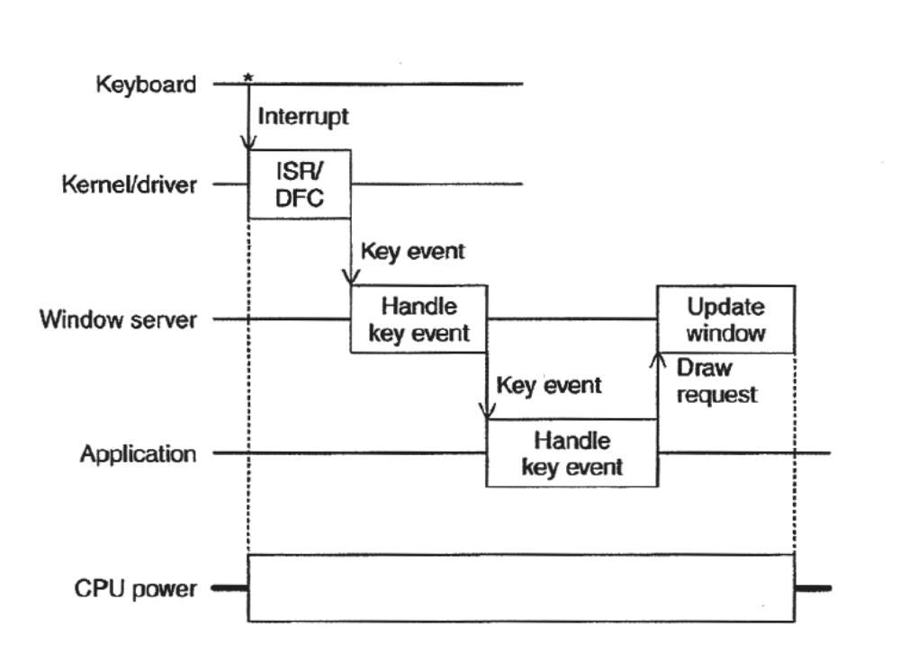
Response to Input Key Press
Notes:
Consider an EPOC Word application.
The I/O device responsible for looking after the keyboard generates an interrupt.
The kernel handles the event, interrogates the device, finds the ASCII key code to assignand creates an event for whichever program s interested in raw key events.
The windows server then determines which application is currently receiving keystrokes and sends the event to that application; in this case EPOC Word.
EPOC Word then handles the key by perhaps odifying the text.
The windows server updates the display.
ISR = Interrupt Service Routine (First level event handling , short)
DFC = Delayed Function Call (Second level event handing)

Slide 5
UI Thread Design
Places objects on screen
Registers callbacks procedures associated with screen & keyboard events
When event occurs, want to pass control to the callback procedure.
Callbacks should execute quickly
UI thread should spend most of the time idle.

Slide 6
Coordination
Do not use normal thread locks as whole application gets blocked since no UI actions can be handled.
import thread
lock = thread.allocate_lock()
Use e32.Ao_lock instead. Preserving the responsiveness of the UI can be done with the help of active objects.

Slide 7
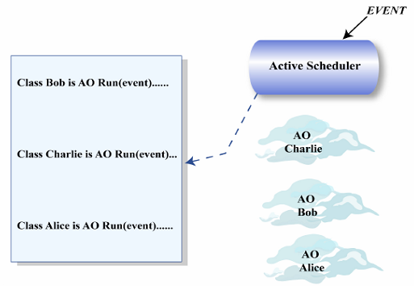
Active Objects
Active Objects can be thought of as “listeners”
Get called by scheduler (have a little bit of state)
Run to completion then return to scheduler.
Notes:
All EPOC threads are essentially event handlers with a SINGLE active sheduler per thread coorporating with one or more active objects to handle events from devices and other programs.

Slide 8
Active Objects
Each active object has virtual member function called RunL()
gets invoked when event happens
  events have associated priority
Active Objects execute non-preemptively
  RunL() should execute for short time
  no need for mutex, semaphores, critical sections
  fewer context-switches
Compute-intensive threads:
  Simulate using pseudoevents
  split task into pieces, generate low-priority event

Slide 9
Multitasking and Preemption
Threads implement preemptive multitasking. E.g. windows server can handle a key event while an application is running by preempting the running application thread.
Preempting depends on thread priorities.

Slide 10
Multitasking and Preemption
AO implement non-preemptive multitasking within the context of a single thread because each event must be completely handled by RunL() before the next event on the thread is handled.
AO also have priorities to determine which AO’s RunL should be completed.
Windows server uses a single thred but uses Aos to handle key events, screen drawing, requests from GUI apps.

Slide 11
Why AOs are better than threads?
No need of preemption in a truly event handled system.
No need of mutexes, semaphores or synchronization.

Slide 12
Where Threads Matter
Long running threads like game engine calculations, background printing…
Simulate the thread using active objects with chains of pseudo events.
OR
Really use multithreading. Launch a background thread and have the app’s ain thread communicate with the background thread. (hard to implement and not recommended)

Slide 13
Python’s Active Objects
Previous discussion was for Symbian in general
Python hides the scheduler
Can control AO by allocating an e32.Ao_lock() and then doing wait() and signal() with this lock.

Slide 14
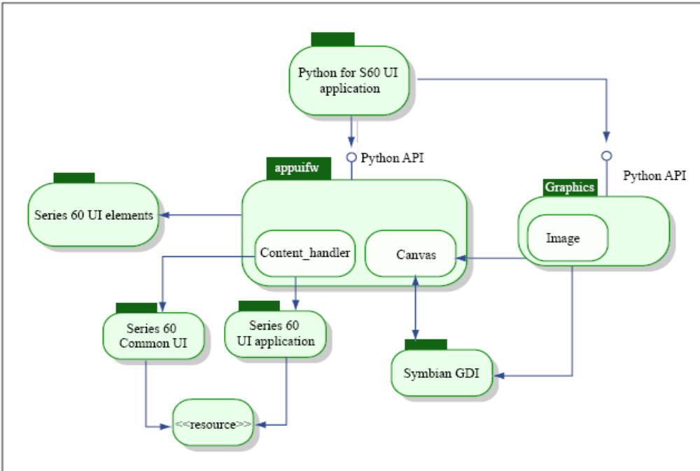
Python UI Framework
Reference: Larry Rudolph, MIT

Slide 15
PyS60: Making Programs Pretty

Slide 16
Graphics Capabilities
‘graphics’ module.
Graphics primitive access.
Image loading,saving, resizing and
transformations. (S60 2nd edition and above)

Slide 17
Module Level Free Function
Image screenshot(): Takes a screenshot of
your phone.
import graphics
img = graphics.screenshot()
img.save(u‘E:\\screenshot.png')

Slide 18
Image Class Static Methods
Image Image.new(size[, mode=‘RGB16’])
where: size is a two-element tuple
mode specifies the bits per pixel.
Bits per pixel describes the number of bits
used to represent the color of a single pixel
in a bitmapped. Higher color depth gives a
broader range of distinct colors.

Slide 19
Image Class Static Methods
Image Image.open(filename)
jpg and png are supported file formats.
Filename should be fully qualified path.

Slide 20
Image Object Methods
Resize (newsize [, callback = None, keepaspect = 0])
Similar methods for transpose, load, save, compression.

Slide 21
Drawable Objects
Canvas from appuifw module.
Image from graphics module.
Common methods to draw a line, polygon, rectangle, ellipse, pieslice, arc, point, clear, text, blit (copies the source area from the given image to the target area)
Each method takes a set of options: outline, fill, width, pattern.
Coordinate sequence of (x, y) coordinates.

Slide 22
In-Class Example
Take ball.py and add the following:
key 4 (keyboard.pressed(EScancode4)): to shrink the ball.
key 7 (keyboard.pressed(EScancode7)): to increase the size of the ball.
key 6 (keyboard.pressed(EScancode4): change colour of the point to yellow (0xffff00)

Slide 23
Using the Camera
Program an application that captures an
image from the phone’s viewfinder.

Slide 24
import appuifw, e32, camera
img = None
def __exit__( ):
stop( )
# stops scheduler
script_lock.signal( )
def start( ):
camera.start_finder( vfCallback )
appuifw.app.menu = [(u'Capture', capture), (u'Stop', stop), (u'Exit', __exit__)]
def stop( ):
camera.stop_finder( )
cnvCallback( )
appuifw.app.menu = [(u'Start', start), (u'Save', capture), (u'Exit', __exit__)]

Slide 25
def vfCallback( aIm ):
global img
appuifw.app.body.blit( aIm )
img = aIm
def cnvCallback( aRect=None ):
if img != None:
appuifw.app.body.clear( )
appuifw.app.body.blit( img )
def capture( ):
camera.stop_finder( )
cnvCallback( )
appuifw.app.menu = [(u'Start', start), (u'Exit', __exit__)]
img.save(u'E:\\Images\\viewfinder.png')
appuifw.note(u'Saved', 'info')

Slide 26
# Main script starts here...
# start AO scheduler
script_lock = e32.Ao_lock( )
appuifw.app.exit_key_handler = __exit__
appuifw.app.title= u'Camera ViewFinder App'
appuifw.app.body = appuifw.Canvas( redraw_callback = cnvCallback)
start( )
script_lock.wait( )

Slide 27
Other Resources
imgviewer.py
For complete API descriptions for graphics and camera modules refer to the PyS60 API Reference document.

Slide 28
Next Class
Finishing up the PyS60 module.
Need to email me a time and date to show your assignment.

